Slide 1

WHILE LOOPS
IN PYTHON

Slide 2
OUTLINE
01
02
03
04
THE WHILE LOOP
THE BREAK STATEMENT
THE CONTINUE STATEMENT
THE ELSE STATEMENT

Slide 3
01
WHILE LOOPS
One of the 2 kinds of loops in python

Slide 4
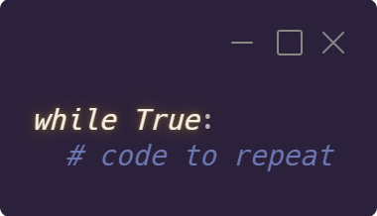
A while loop repeatedly executes statements as long as a condition is true

Slide 5
02
BREAK STATEMENT
Used to stop the loop even if the conditional is true

Slide 6
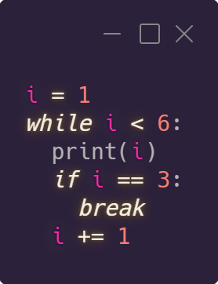
Used to stop the loop even if the conditional is true

Slide 7
03
CONTINUE STATEMENT
Stop the current run but continue with the next

Slide 8
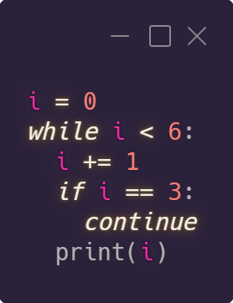
Used to stop the current run and continue with the next

Slide 9
04
ELSE STATEMENT
Runs this block of code once condition for while loop is no longer true

Slide 10
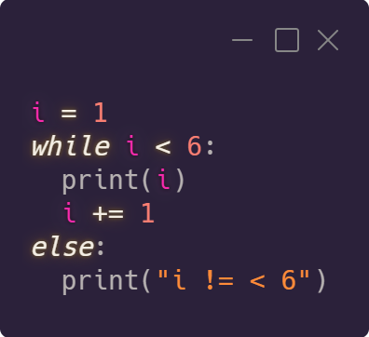
Runs this block of code once condition for while loop is no longer true

Slide 11
WEEKLY TASK: FIZZ BUZZ
Multiples of 3 are replaced with the word “fizz”
Multiples of 5 are replaced with the word “buzz”
Multiples of both are replaced with the word “fizzbuzz”
Done for the number 1 to 100
Say “done” after reaching the number 100
BONUS
Let the user choose what number to end at

Slide 12

THANKS
Create a ticket on discord if you need help

